Slide 1


How to use Constellate?
A success guide to Constellate

Slide 3

Constellate is the only text & data analysis platform that integrates access to scholarly content and open educational resources into a cloud-based application and lab to help faculty, librarians, and other instructors easily teach text and data analysis.
With Constellate, learners across all disciplines can apply text analysis methods to content, hone their skills with our on-demand tutorials, attend live classes taught by the experts at Constellate, and engage with our inspiring user community.

Slide 4



Constellate
Teach
Learn
Perform

Slide 5

Log in
constellate.org

Slide 6
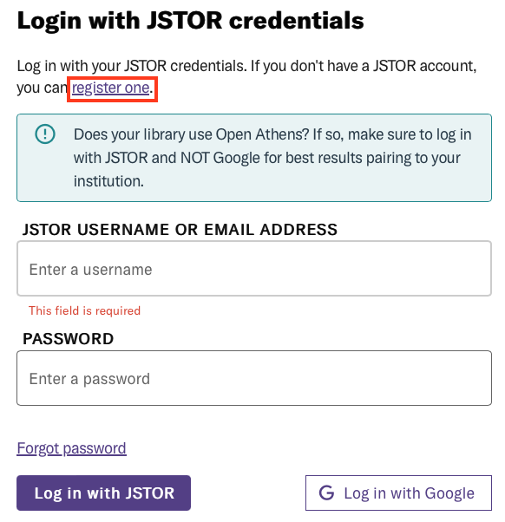
If you do not have an account yet…

Slide 7
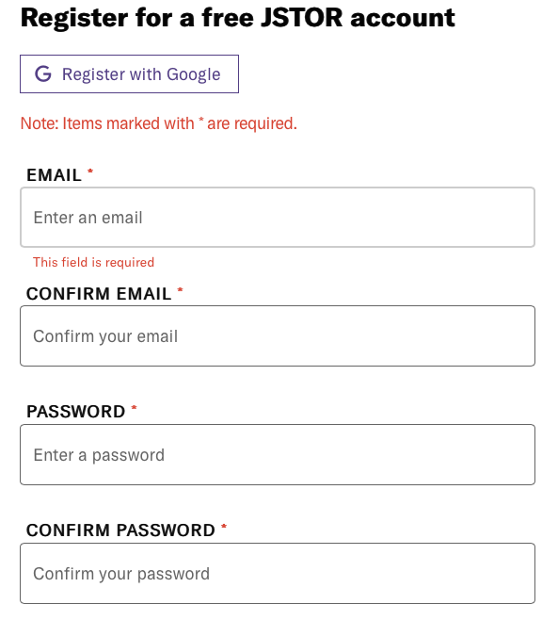
If you do not have an account yet…

Slide 8
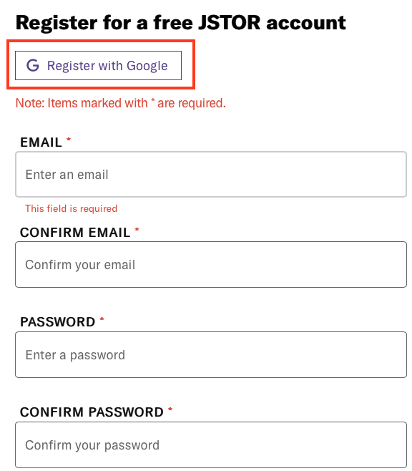
If you do not have an account yet…

Slide 9
With an account set up…
constellate.org

Slide 10
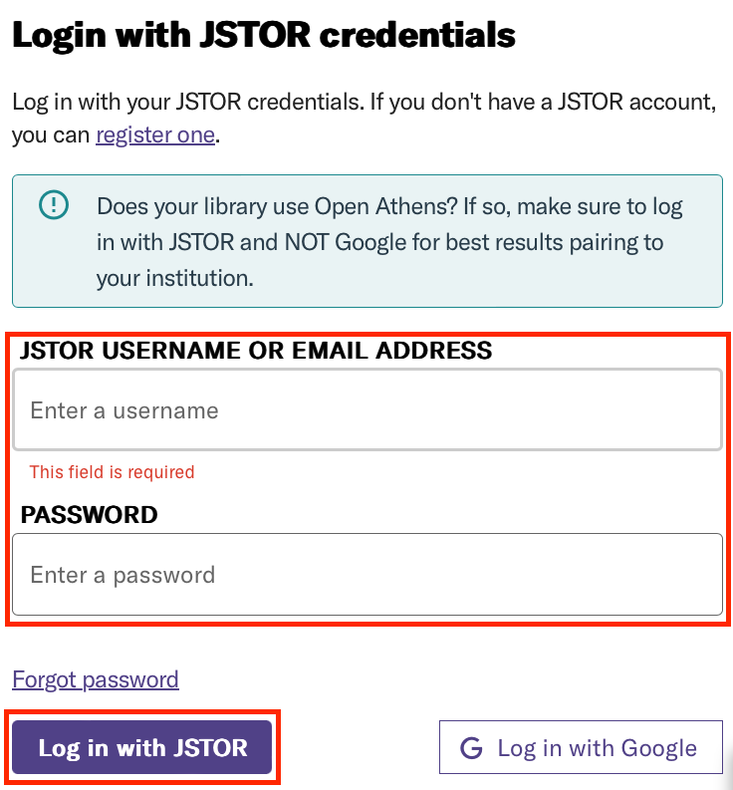
Log in with JSTOR account…

Slide 11
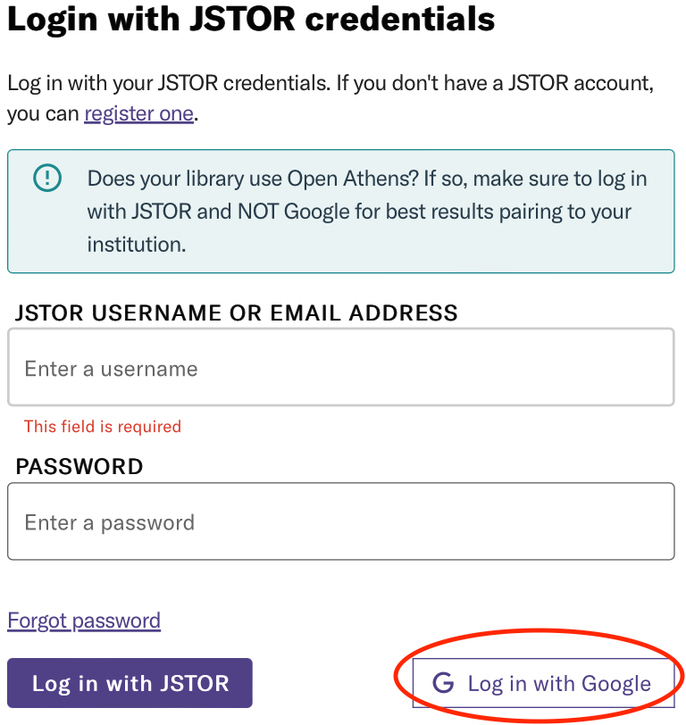
Log in with Google…

Slide 12
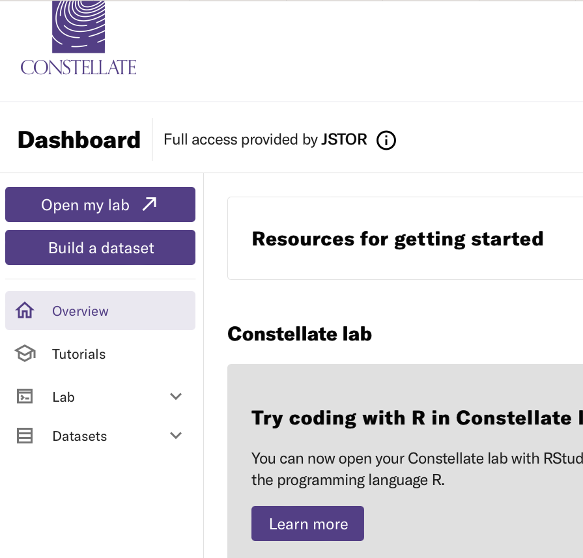
After you are logged in

Slide 13
Let’s get logged in!

Slide 14
Roadmap
The dataset builder
Visualizations
The dashboard

Slide 15
The practice of extracting information from collections of text (both small and large collections) to discover new ideas or answer research questions.
What is text analysis?

Slide 16
collections of text
What is text analysis?

Slide 17
The dataset builder

Slide 18

The dataset builder

Slide 19
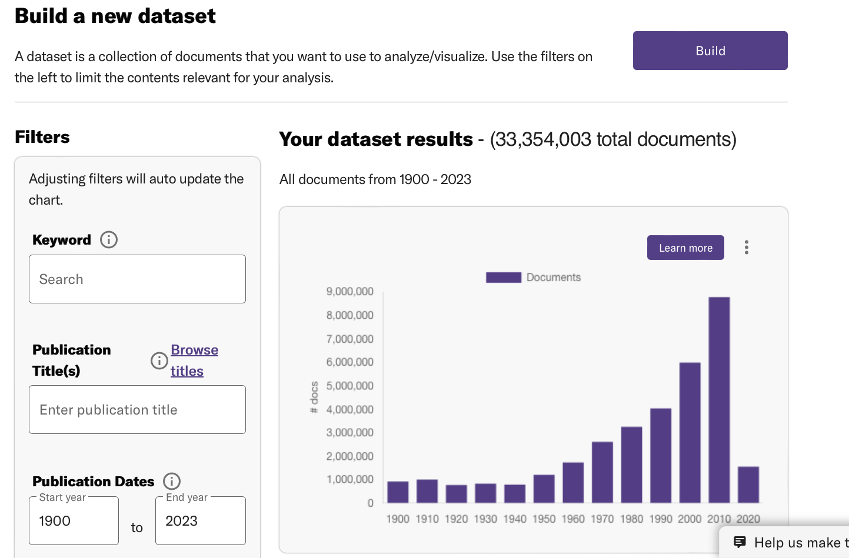
The dataset builder

Slide 20
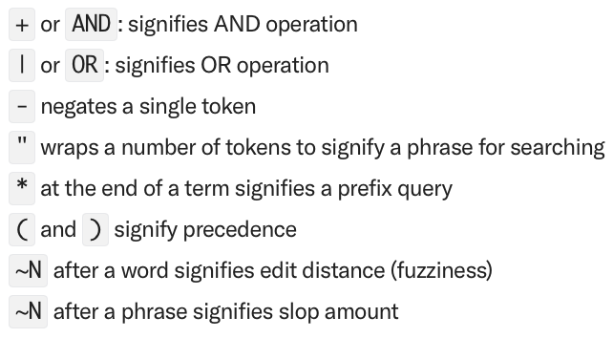
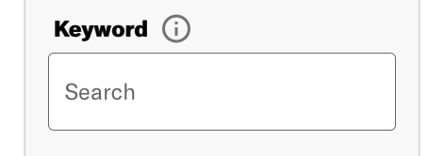
The keyword filter

Slide 21
The keyword filter
"foster care" AND (adopt* OR reunification OR reunifies OR reunify)

Slide 22
The keyword filter
title:taxes AND creator:smith

Slide 23
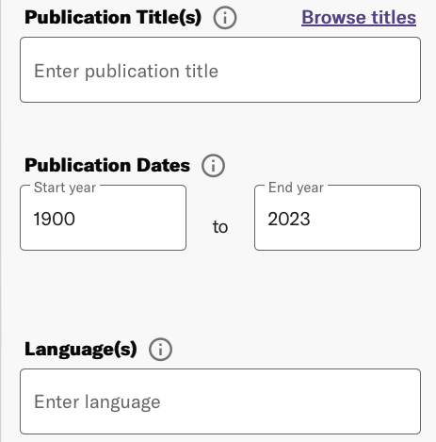
Other filters

Slide 24
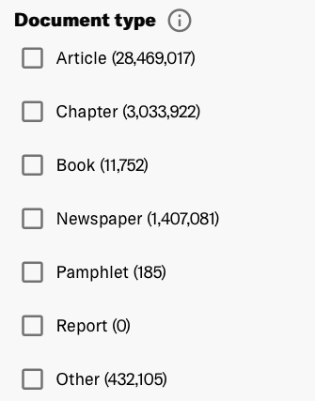
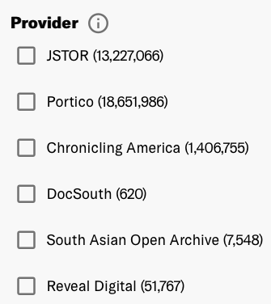
Other filters

Slide 25
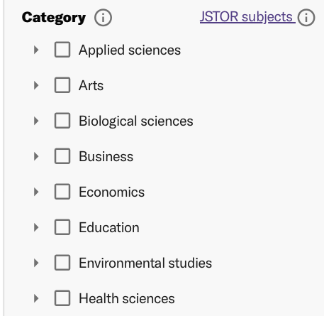
Other filters

Slide 26
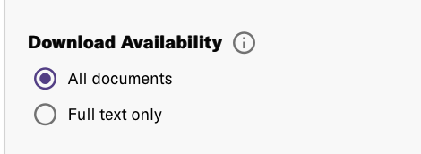
Other filters

Slide 27
Between search filters: AND
If you enter the keyword search income taxes and select JSTOR from the provider filter you will be filtering for documents that match income taxes and are from JSTOR.

Slide 28
Within search filters: OR
If you enter the keyword search income taxes and select JSTOR from the provider and you next select Portico form the provider filter, your query will be income taxes AND (JSTOR OR Portico).

Slide 29
Within search filters: OR
If you enter the keyword search income taxes and select JSTOR from the provider and you next select Portico form the provider filter, your query will be income taxes AND (JSTOR OR Portico).

Slide 30
More details
https://constellate.org/docs/how-to-build-a-dataset
https://constellate.org/docs/create-a-dataset-from-a-list-of-titles
https://constellate.org/docs/create-a-dataset-with-text-files
https://constellate.org/docs/how-the-search-engine-works
https://constellate.org/docs/filter-on-docsubtype

Slide 31
A simple example

Slide 32
Dataset types
Metadata
Textual data

Slide 33
Dataset types
Metadata
Textual data
Ngrams
Unigrams
Bigrams
Trigrams
Full text

Slide 34
File format
The dataset builder creates three kinds of files:
A CSV file containing only metadata
A CSV file containing only unigrams or bigrams or trigrams.
A JSON Lines file containing all of metadata, unigrams, bigrams, trigrams and full text if full text is available

Slide 35
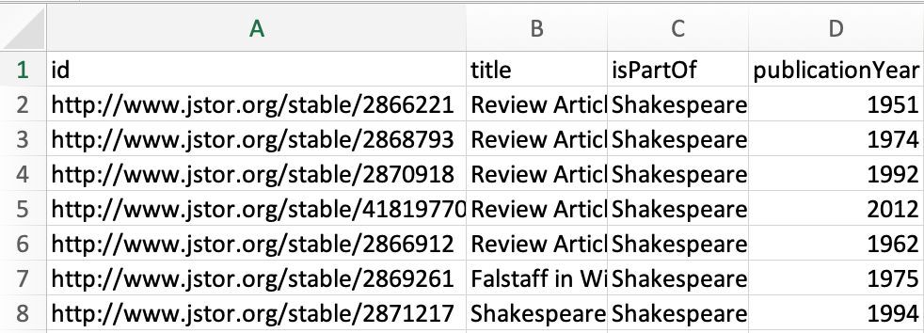
Metadata

Slide 36
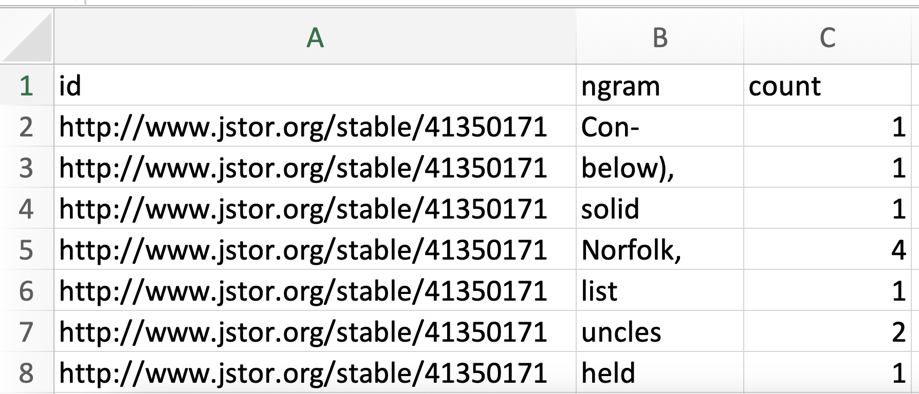
Unigrams

Slide 37
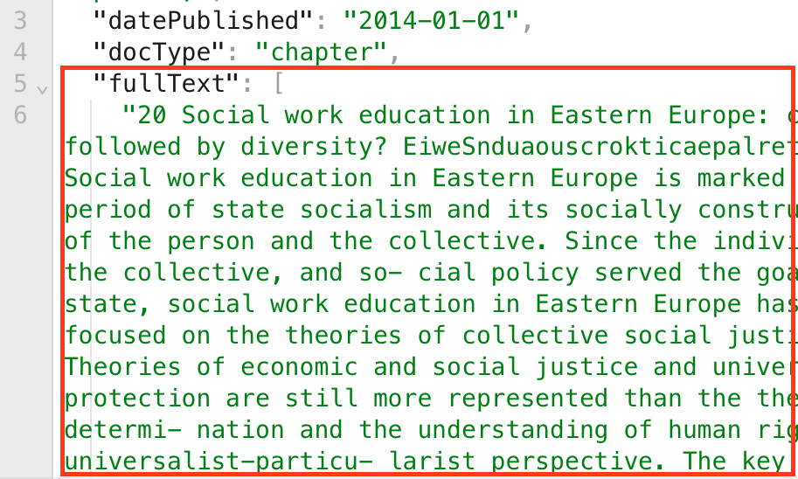
Full Text

Slide 38
Download options
If you are only exploring…
sampled metadata (CSV)
sampled metadata, ngrams, (some) full-text (JSONL)

Slide 39
Download options
If you want the full dataset…
metadata (CSV)
unigrams (CSV)
bigrams (CSV)
trigrams (CSV)
metadata, ngrams, and (some) full-text (JSONL)

Slide 40
Build a dataset and download it

Slide 41
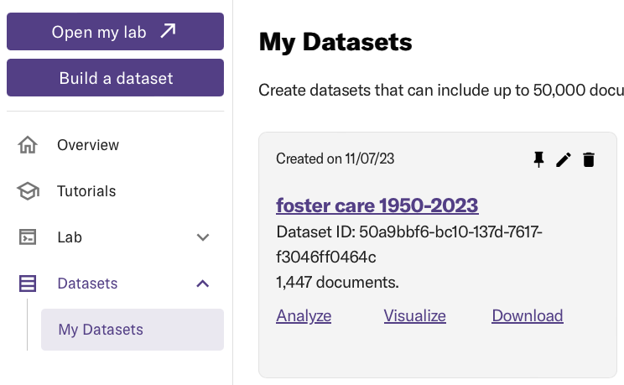
Datasets

Slide 42
Share and download

Slide 43
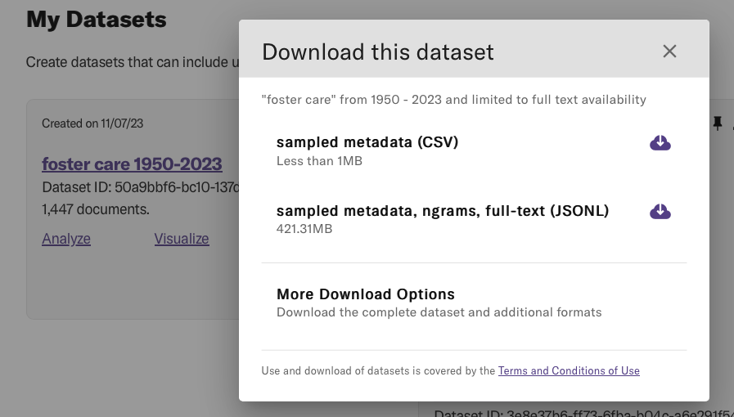
Share and download

Slide 44
Share and download

Slide 45
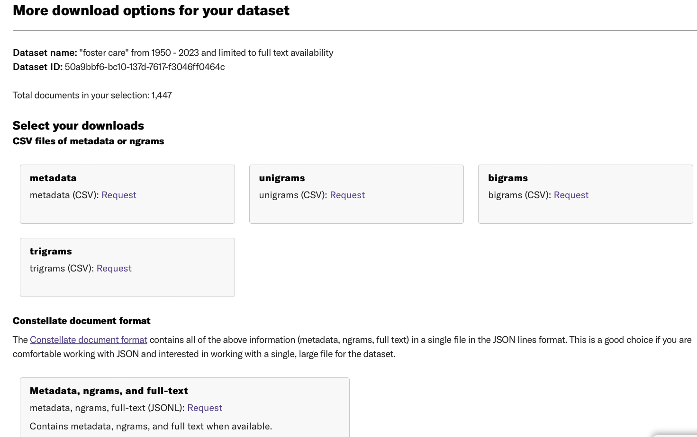
Share and download

Slide 46
Download options
If you are from a participating institution
1500 sampled items
Full datasets of up to 50,000 items
Up to 10 datasets a day

Slide 47
Download options
If you are from a non-participating institution
1500 sampled items
Full datasets of up to 25,000 items
Up to 10 datasets a day

Slide 48
Any questions?

Slide 49
Roadmap
The dataset builder
Visualizations
The dashboard

Slide 50
Visualizations

Slide 51
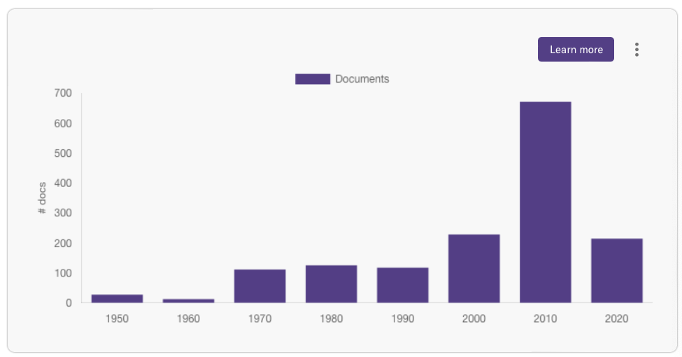
Overview
"foster care" from 1950 - 2023 and limited to full text availability

Slide 52
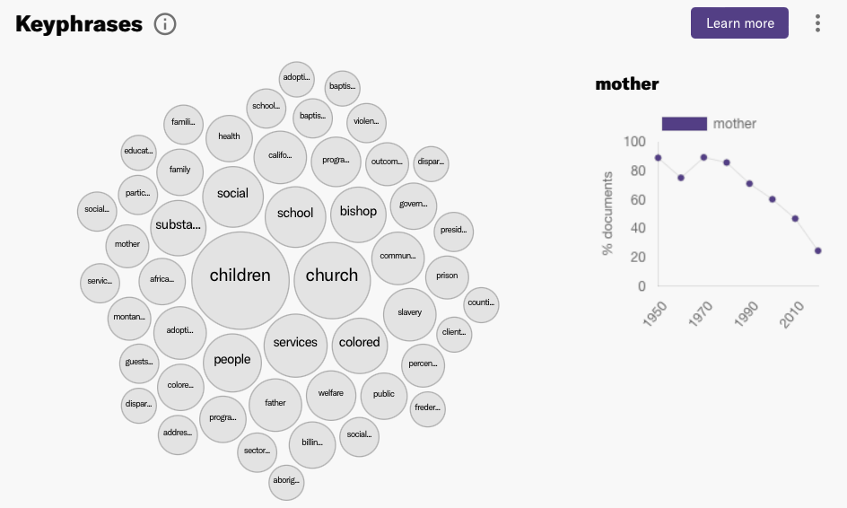
Keyphrases
"foster care" from 1950 - 2023 and limited to full text availability

Slide 53
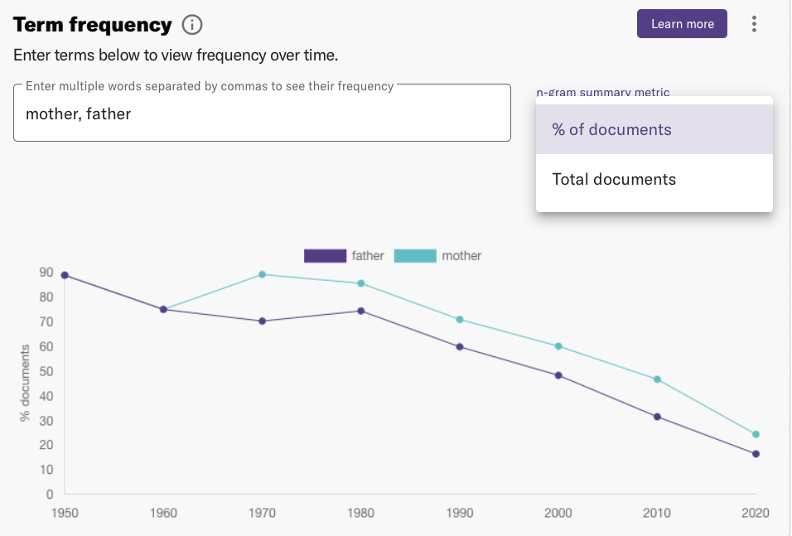
Term frequency
"foster care" from 1950 - 2023 and limited to full text availability

Slide 54
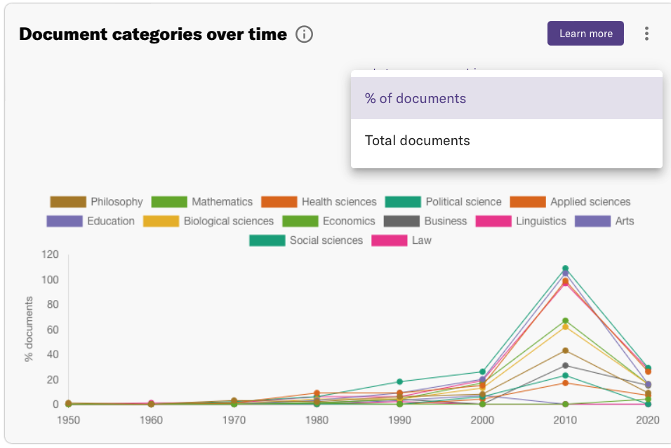
Document categories
"foster care" from 1950 - 2023 and limited to full text availability

Slide 55
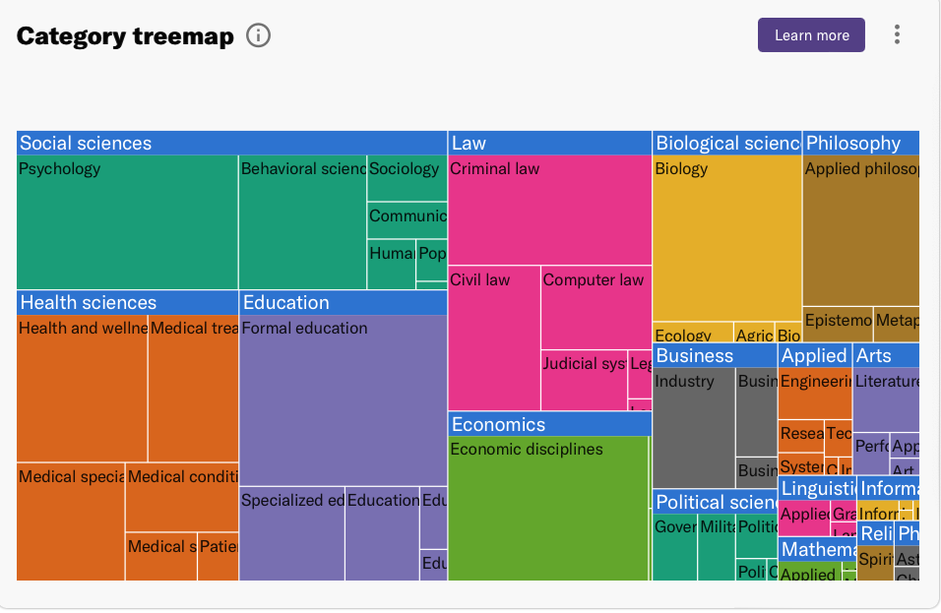
Category treemap
"foster care" from 1950 - 2023 and limited to full text availability

Slide 56
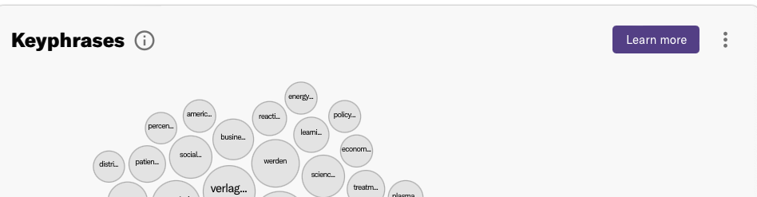
Share and download
You may download and share these visualizations from those three dots stacked in a vertical column on each visualization.
"foster care" from 1950 - 2023 and limited to full text availability

Slide 57
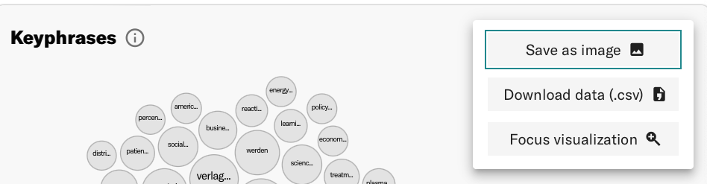
Share and download
You may download and share these visualizations from those three dots stacked in a vertical column on each visualization.
"foster care" from 1950 - 2023 and limited to full text availability

Slide 58
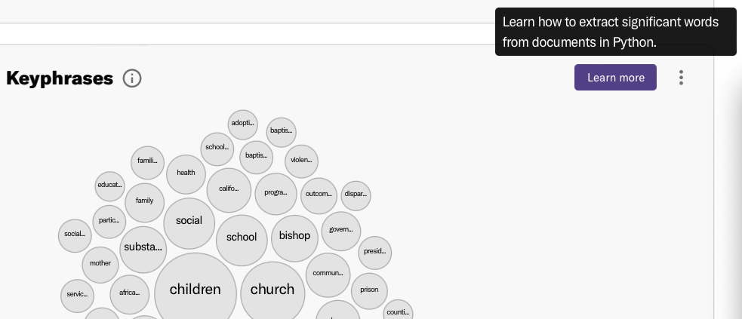
Learn more
"foster care" from 1950 - 2023 and limited to full text availability

Slide 59
Let’s go play with the visualizations

Slide 60
Any questions?

Slide 61
Roadmap
The dataset builder
Visualizations
The dashboard

Slide 62
The dashboard

Slide 63
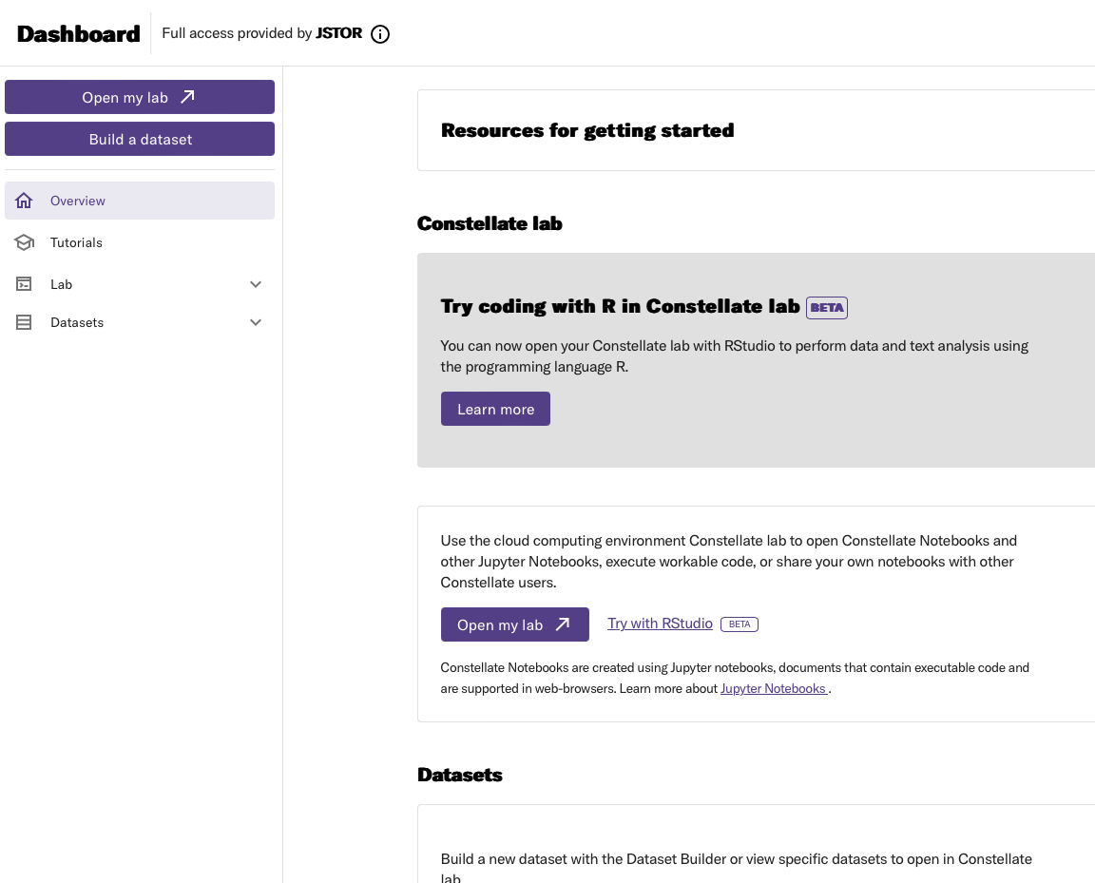
Your dashboard

Slide 64
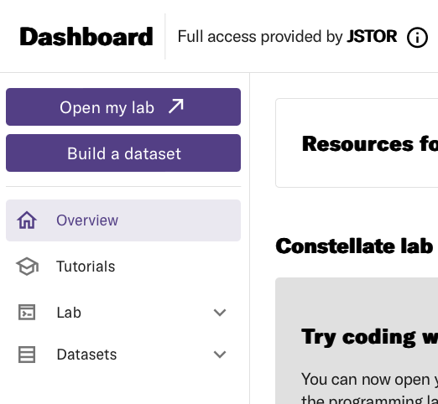
The left menu pane

Slide 65
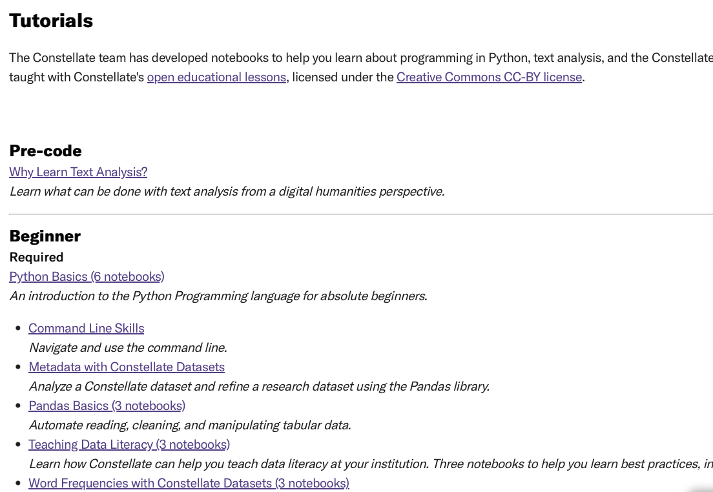
Tutorials

Slide 66
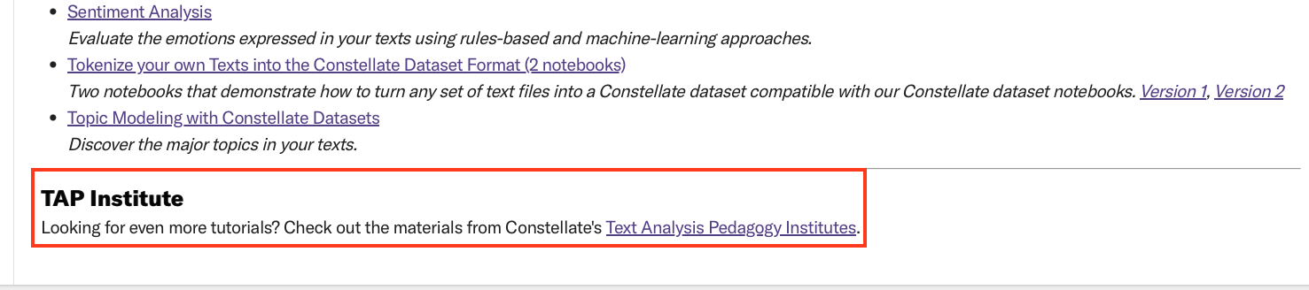
Tutorials

Slide 67
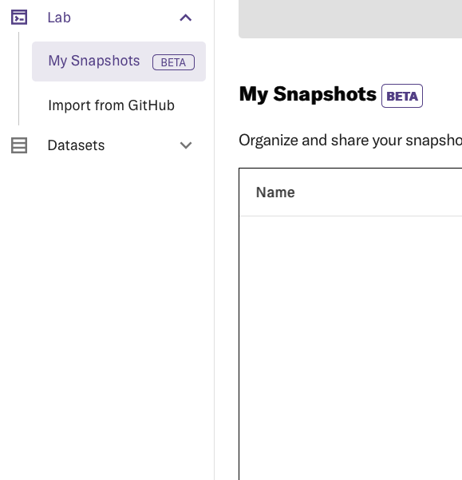
Lab

Slide 68
Datasets

Slide 69
What is the Constellate Lab?

Slide 70

Constellate lab
Teach
Learn
Perform

Slide 71
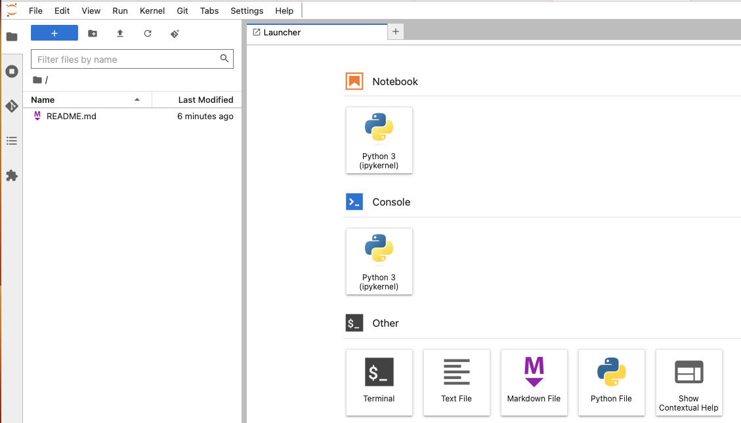
Start state

Slide 72
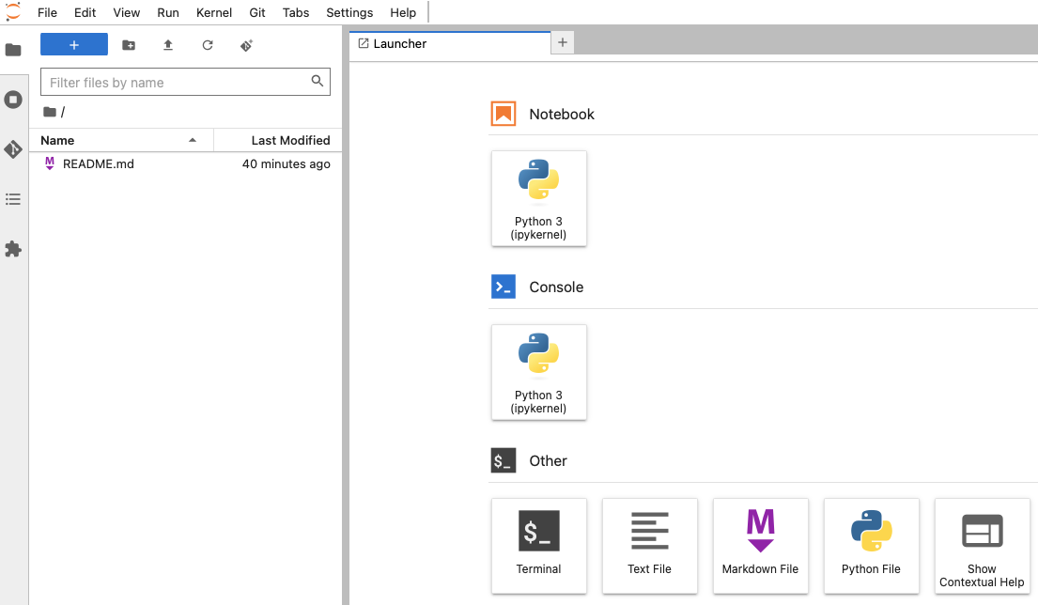
The lab interface
The menu bar
The left sidebar
The main work area

Slide 73
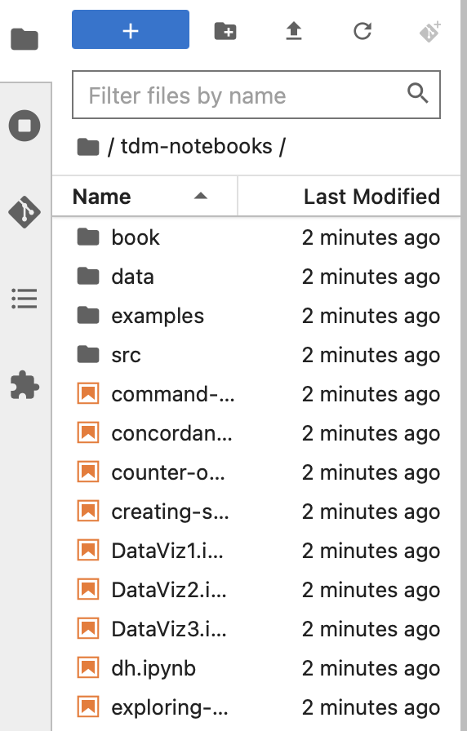
The left sidebar
File browser
List of tabs in the main work area
and of running kernels and terminals
Git
Table of contents
Extension manager

Slide 74
The left sidebar
File browser

Slide 75
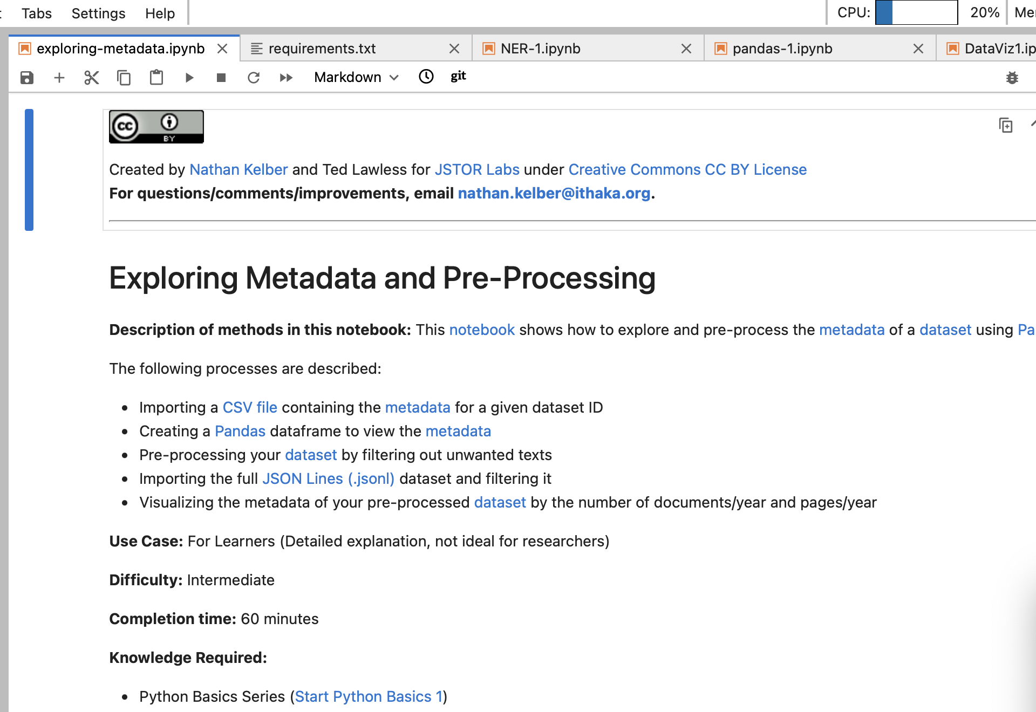
The main work area

Slide 76
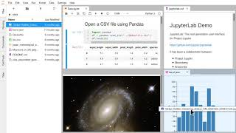
The main work area

Slide 77
If you are learning Constellate notebooks…

Slide 78
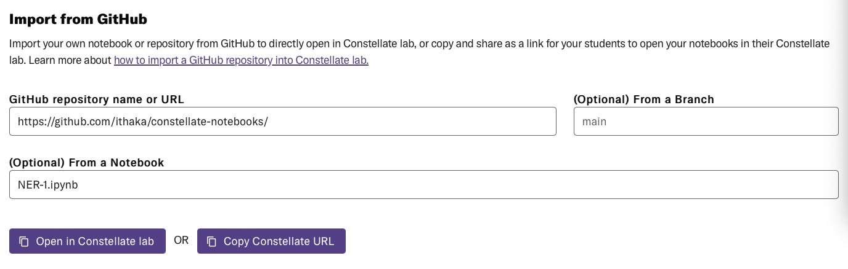
If you are teaching with your own notebooks…

Slide 79
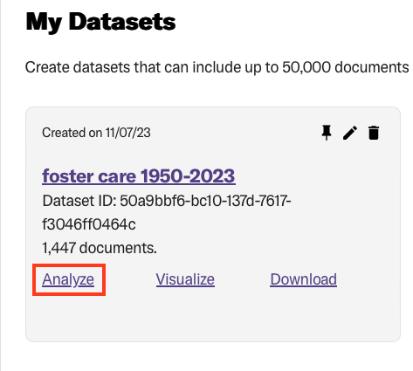
If you have built a dataset and would like to analyze it…

Slide 80
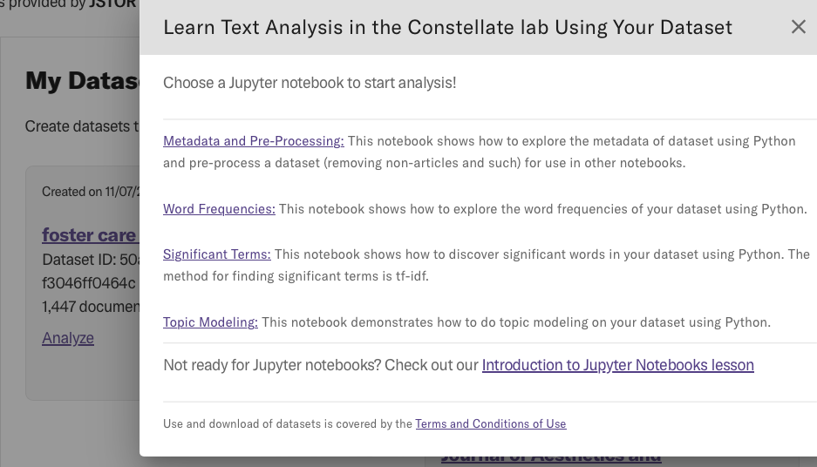
If you have built a dataset and would like to analyze it…

Slide 81
Remove the highlights
To look like this
# Check if a data folder exists. If not, create it.
data_folder = Path('../data/')
data_folder.mkdir(exist_ok=True)
# Check to see if a dataset file exists
# If not, download a dataset using the Constellate Client
# The default dataset is Shakespeare Quarterly, 1950-present
dataset_file = Path.cwd() / '..' / 'data' / 'my_data.jsonl.gz' # Make sure this filepath matches your dataset filename
# Check if a data folder exists. If not, create it.
data_folder = Path('/data/')
data_folder.mkdir(exist_ok=True)
# Check to see if a dataset file exists
# If not, download a dataset using the Constellate Client
# The default dataset is Shakespeare Quarterly, 1950-present
dataset_file = Path.cwd() / 'data' / 'my_data.jsonl.gz' # Make sure this filepath matches your dataset filename

Slide 82

Sharing files on Constellate
Snapshots
Build a lesson in the Constellate lab, create a snapshot, and share it with your students the day of the lesson
Have your students work in the Constellate Lab, create a snapshot of their work, and share it with you for review
Share your work-in progress notebook with a collaborator
Any other collaborative need

Slide 83
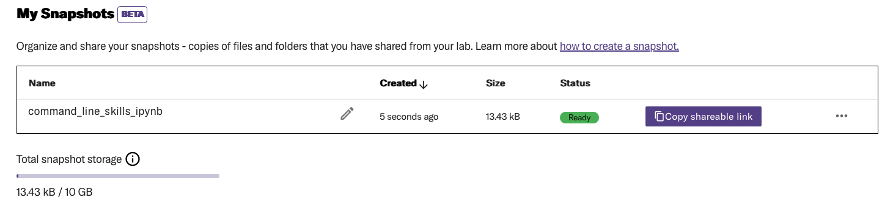
Snapshots
You can include in a snapshot a single file, or a directory of files and as many subdirectories as you want. The total size of a single snapshot must be under 2GB.
Depending on the size of the file/s or folder/s, successful snapshot links still may be in the process of uploading contents when you share them. To know if the snapshot link is ready for other users to view, visit My Snapshots in the Dashboard.

Slide 84
Snapshots
New changes → New snapshots
If you make changes to a file or directory after taking a snapshot, these changes are not automatically reflected in any existing snapshots. To capture these new changes, you must take a new snapshot and share that with your students or collaborators.

Slide 85
Let’s take a snapshot!

Slide 86
Sharing files on Constellate
New changes → New snapshots
If you make changes to a file or directory after taking a snapshot, these changes are not automatically reflected in any existing snapshots. To capture these new changes, you must take a new snapshot and share that with your students or collaborators.

Slide 87
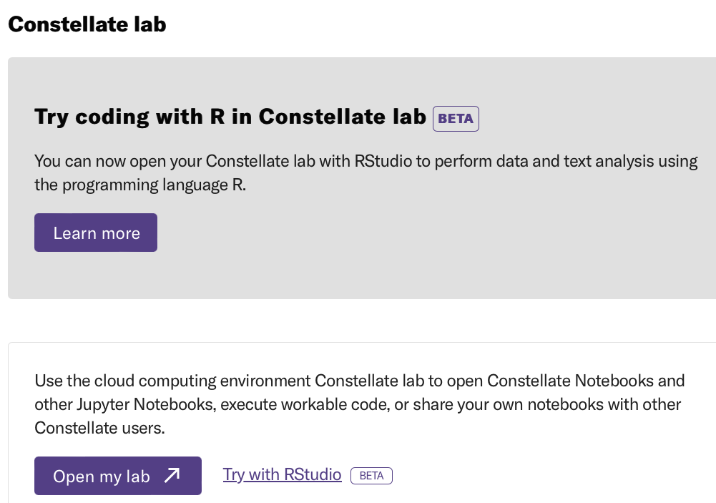
RStudio

Slide 88
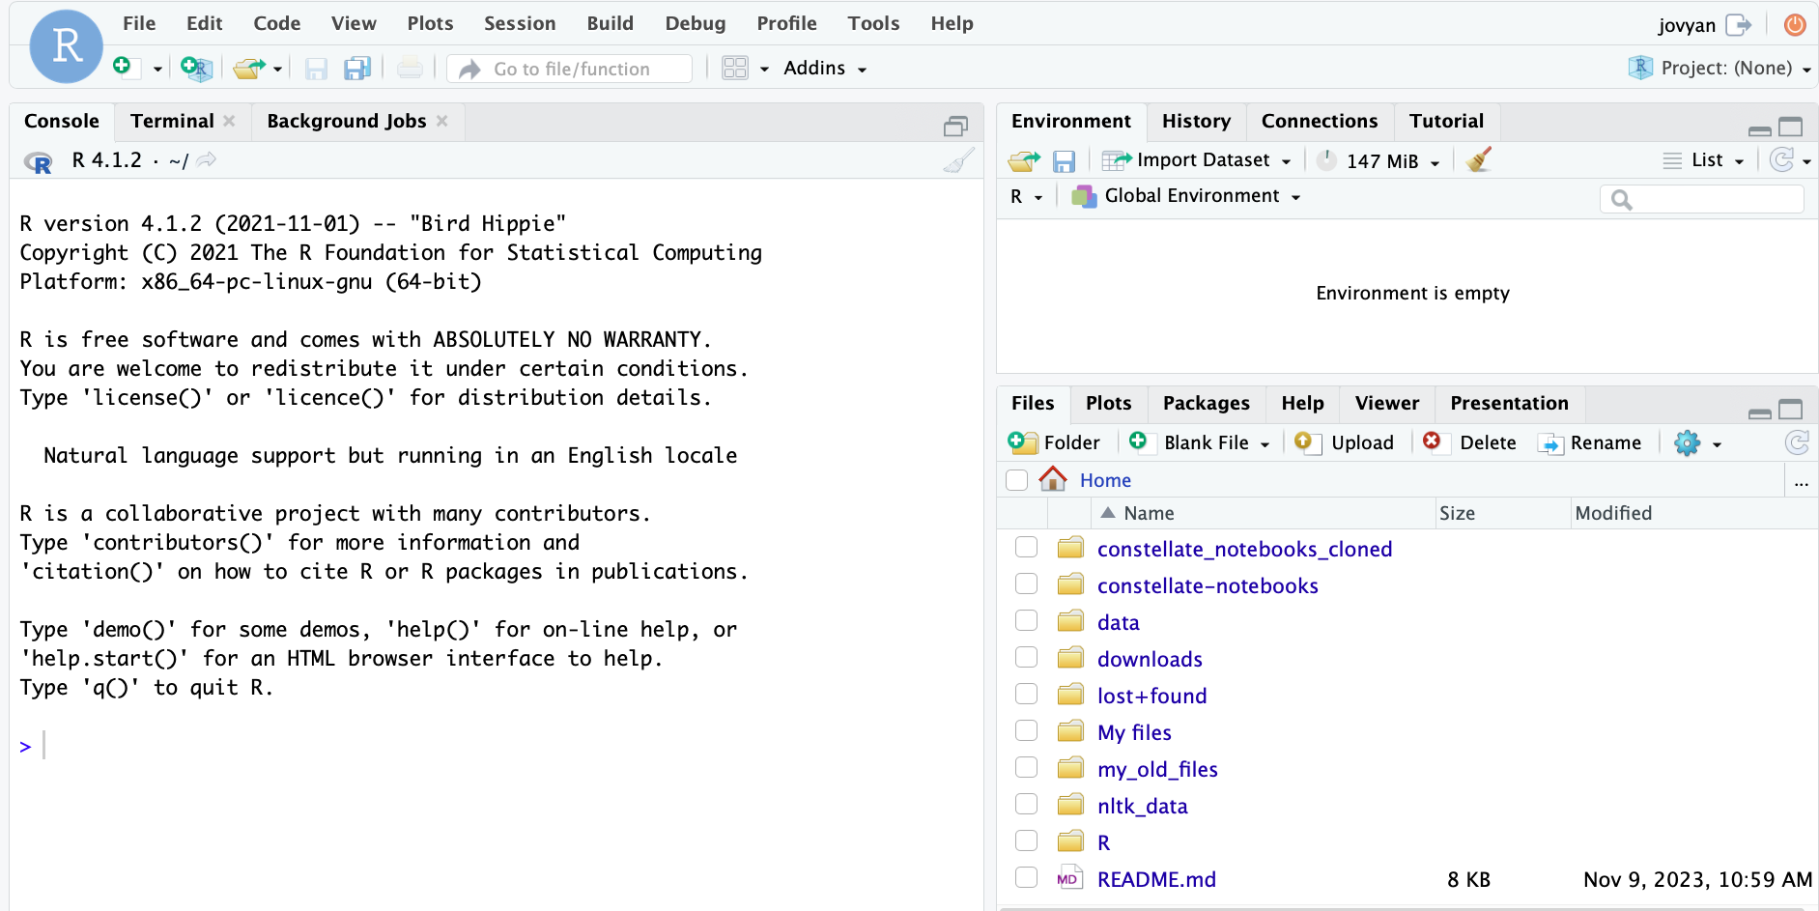
RStudio

Slide 89
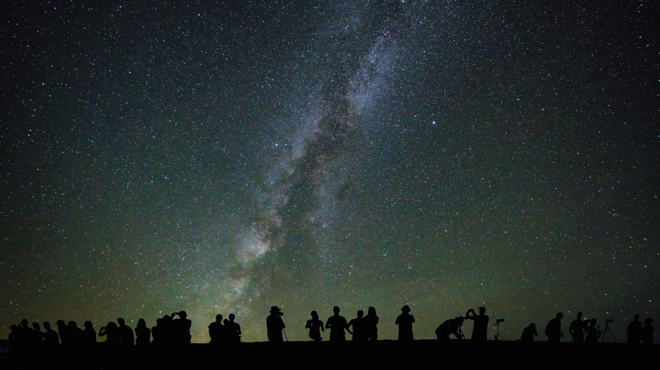
constellate.org
constellate@ithaka.org

